Slide 1
E-Governance : Digital Government Service
Presented by: Prajwal Raj Sangorula
Class:12
Section : E

Slide 2
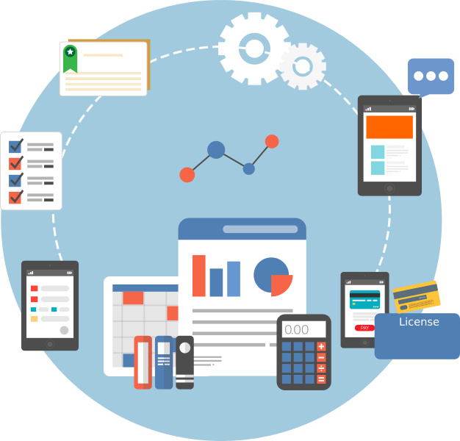
What is E‑Governance?
- Use of digital tools to deliver government services
-Services provided through websites, apps, and online systems
- Makes services faster & more transparent
- Example: Paying bills online

Slide 3
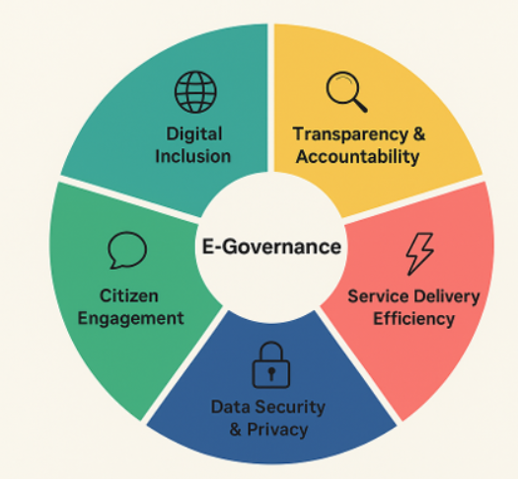
Why E‑Governance Matters
- Saves time and money
- Reduces queues
- Reduces corruption
- Services available anytime
- Improves trust in government

Slide 4
Objectives of E‑Governance
- Faster service delivery
- Less paperwork
- High transparency
- Easy access for citizens

Slide 5
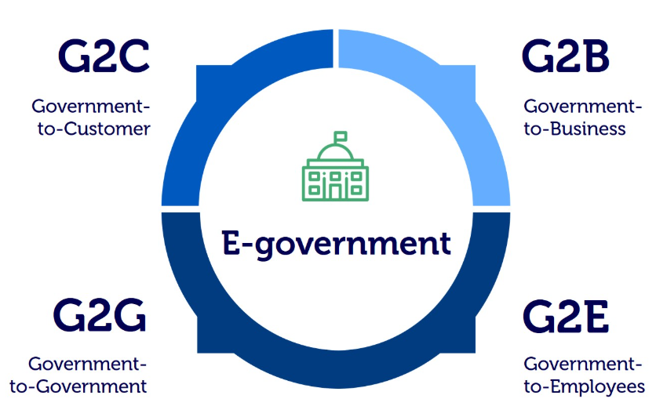
Types of E‑Governance
- G2C – Govt to Citizens
- G2B – Govt to Business
- G2G – Dept to Dept
- G2E – Govt to Employees

Slide 6
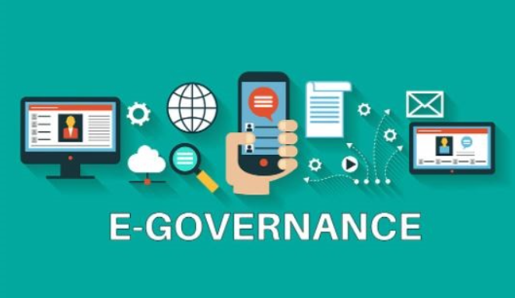
Tools Used in E‑Governance
- Internet
- Websites & Mobile Apps
- Cloud Computing
- Biometrics & Digital Signatures

Slide 7
E‑Governance in Nepal
- Nagarik App
- Online Tax Payment
- Passport & License Services
- Citizenship/ID Status Check

Slide 8
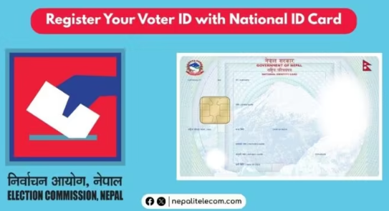
Online Voter Registration in Nepal
- National ID holders can now register online
- Biometric data automatically matched
- No need for office visits
- Around 4 lakh new registrations in recent update

Slide 9
Advantages of E‑Governance
- Better access
- Saves travel & time
- Fewer errors
- Reduces corruption
- Helps economy

Slide 10
Challenges of E‑Governance
- Poor internet in rural areas
- Digital illiteracy
- Technical issues
- Cybersecurity risks
With better networks and awareness, Nepal can overcome these challenges.

Slide 11
Conclusion
- E‑Governance = Faster, simpler, transparent services
- Supports Digital Nepal

